Slide 1
Battle of Neighborhoods
Identifying suitable location to open Italian Cuisine restaurant in New York City
Presentation by: Parag Deshpande

Slide 2
Introduction
New York City, the proverbial ‘Melting Pot’ of the world, is home to the most ethnically diverse population. A home for immigrants from world over, it is but natural that the city is also a gastronomical delight for food lovers across the world, with its rich and varied cuisines reflected in multitude of restaurants catering to cuisines from all over the world. Be it Italian, Mexican, Chinese, Korean, Indian, Lebanese, French, Ethiopian, Japanese – there isn’t a single known world cuisine that does not find itself being represented in some way in this great city.
New York is a major metropolitan area with more than 8.4 million people living within city limits. New York is home to a large swathe of people from Italy with most of the immigration having taken place between 1900 and 1914, when almost two million Italians emigrated to America, most arriving in New York. By 1930 NYC was home to over a million Italian Americans – a whopping 17 percent of the city's population. Most Italian immigrants came from southern Italy and were contadini (landless farmers) fleeing severe poverty.
Presently, there are close to 1 million people of Italian origin, who call New York city their home.

Slide 3
Business Problem
Now coming to the problem at hand, ours is a client very much into the restaurant business, and given the popularity of Italian cuisine, looking for opportunities to serve this need in New York city by opening up an Italian cuisine restaurant.
But given the vastness of the city and the varied neighborhoods, they face a vexing problem:
What would be the ‘Best’ possible location to open a swanky new Italian restaurant in NYC, so that it would do well?
To be able to answer this question, we would look to explore the restaurant scene in New York city, specifically Italian cuisine restaurants. This report explores various neighborhoods and boroughs of NYC to understand the spread of Italian restaurants, their popularity (ratings), what areas have the most Italian restaurants, where are the best rated Italian restaurants located in NYC and so on

Slide 4
Problem Framing
What would be the ‘Best’ possible location to open a swanky new Italian restaurant in NYC, so that it would do well?
How may Italian restaurants be there in NYC and how are they spread / distributed across different boroughs and neighbourhoods?
Where should I go in New York City to have the best Italian food? / Where are the best rated Italian restaurants located in NYC?

Slide 5
Data Requirements
In order to answer the above questions, the data required includes:
New York City neighborhoods and borough with their boundaries, latitudes & longitudes
NYC restaurants, particularly Italian restaurants, along with their stats like Ratings, Tips etc.
The data sources that we propose to use are listed below:
New York City data containing the neighborhoods and boroughs, latitudes, and longitudes will be obtained from the data source: https://cocl.us/new_york_dataset
New York City data containing neighborhood boundaries will be obtained from the data source: https://data.cityofnewyork.us/City-Government/Borough-Boundaries/tqmj-j8zm
For data related to the Italian restaurants including location, ratings, tips etc., Foursquare APIs would be used

Slide 6
Methodology
Data will be collected from https://cocl.us/new_york_dataset and cleaned and processed into a data frame
Foursquare APIs will be used to locate all restaurant venues and then filtered by Italian restaurants.
Ratings, tips, and likes by users will be counted and added to the data frame
Data will be sorted based on rankings (ratings by users, as available on Foursquare)
Data will be plotted and mapped to provide a visual understanding of the analysis, basis which an attempt will be made to arrive at a meaningful conclusion to the given problem

Slide 7
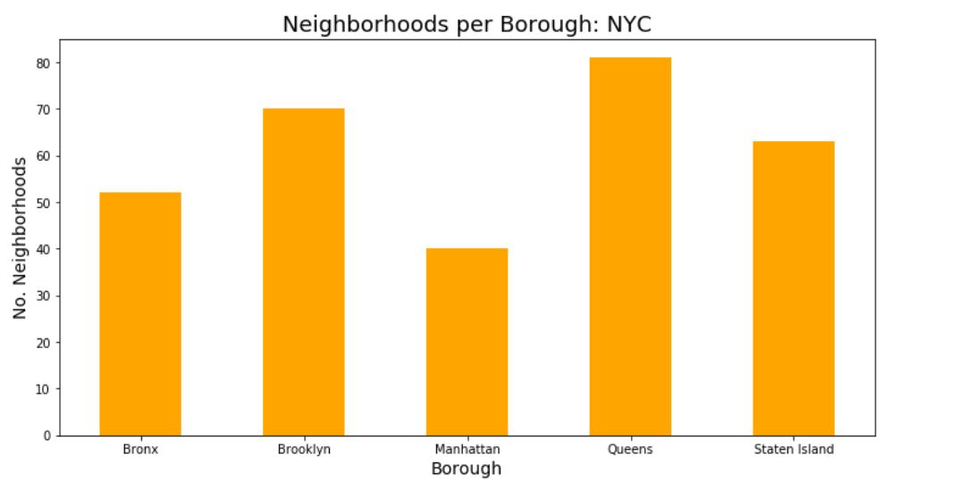
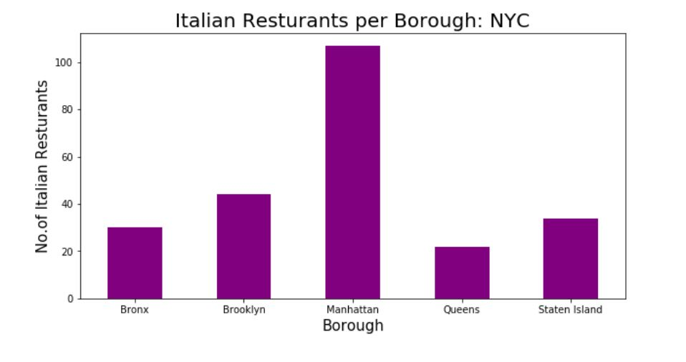
Data Analysis & Discussion (1/5)
New York City has a whopping 237 Italian cuisine restaurants
Manhattan (~40 neighborhoods), the smallest borough, in terms of neighborhoods, has the highest number ( ~110 ) of Italian restaurants
Amongst all boroughs, Queens has the least number of Italian restaurants, followed by The Bronx

Slide 8
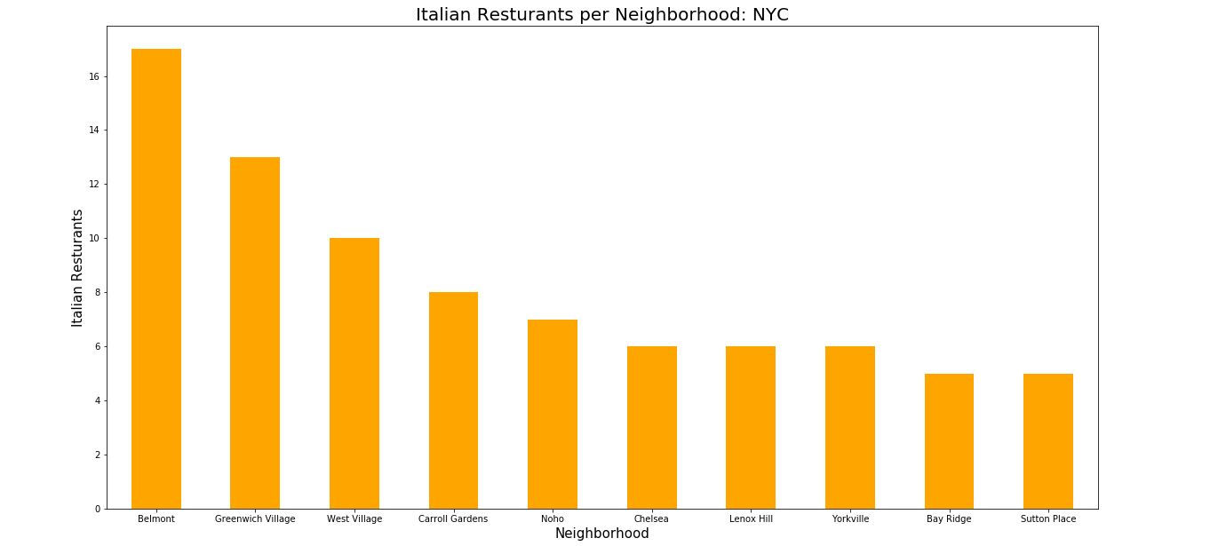
Data Analysis & Discussion (2/5)
Belmont neighborhood in The Bronx has highest number (17) of Italian restaurants, followed by Greenwich Village in Manhattan (13)

Slide 9
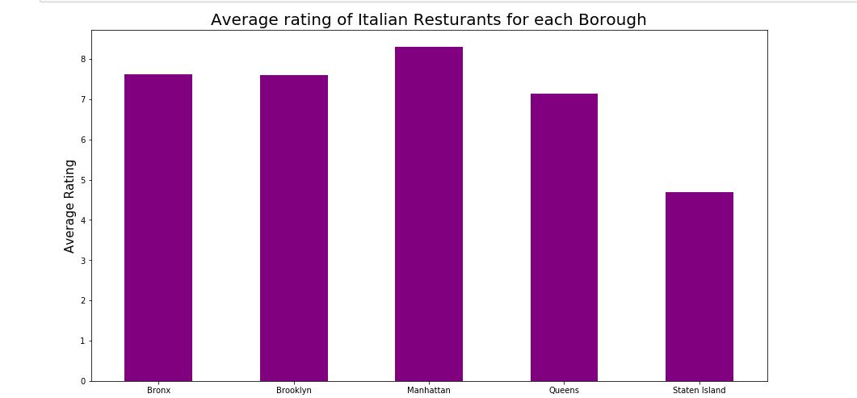
Data Analysis & Discussion (3/5)
Average ratings are the highest for Manhattan (8.3) followed by The Bronx (7.6)
Staten island has the worst average rating for Italian restaurants (4.7)

Slide 10
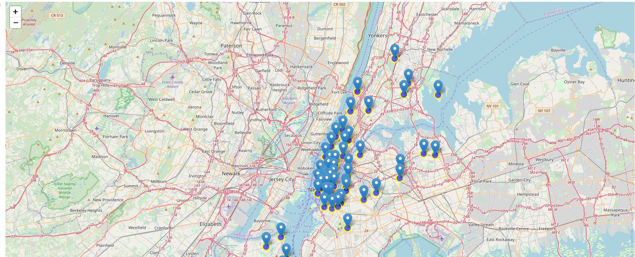
Data Analysis & Discussion (4/5)
Spread of Italian Restaurants with high ratings (>8.0) across New York City

Slide 11
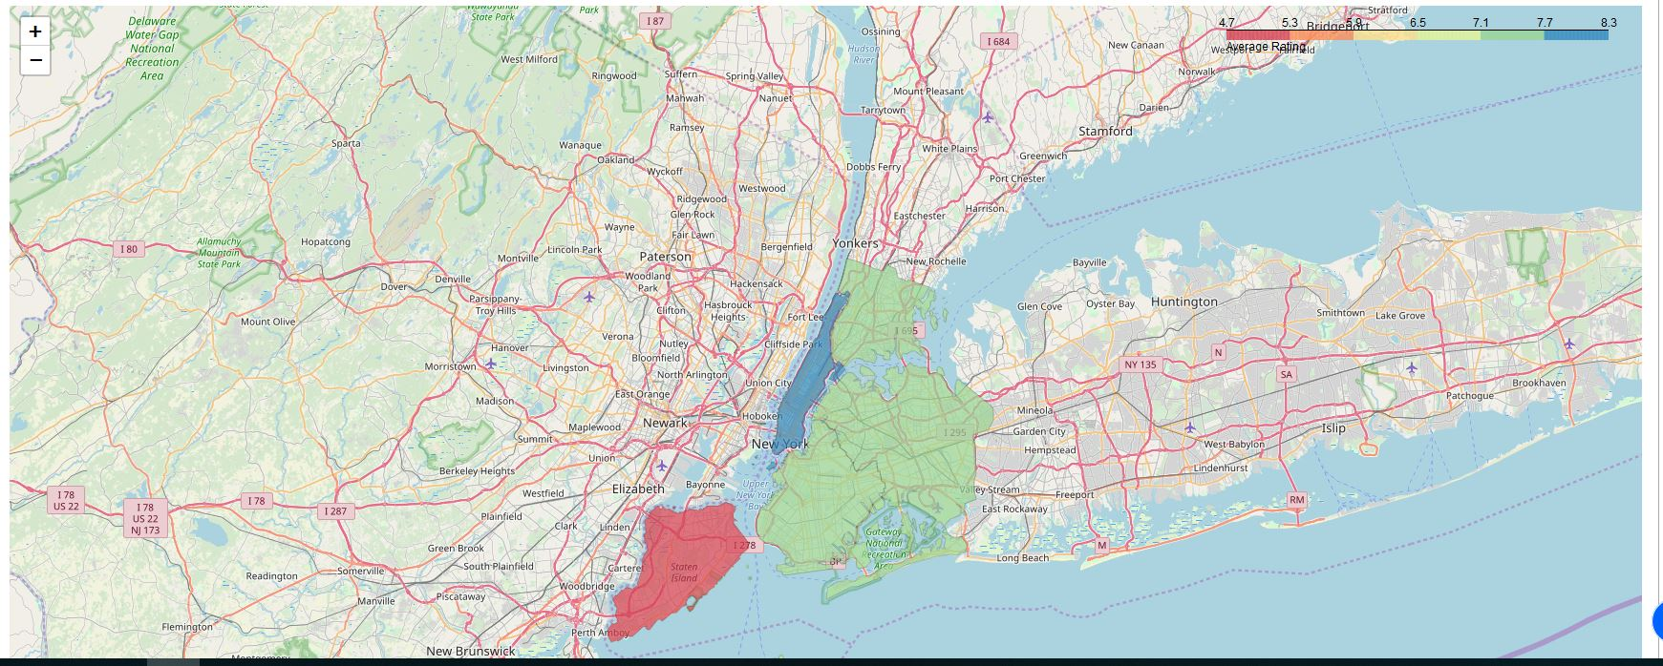
Data Analysis & Discussion (5/5
NYC map showing restaurant density per Borough

Slide 12
Conclusion (1/2)
In terms of spread of Italian restaurants, Manhattan has the most (dense) restaurants, with the highest average ratings
On the other hand, Queens has the least number of Italian restaurants, closely followed by the Bronx (second least). Also, the Italian restaurants in The Bronx have second highest average ratings (7.6)
Given these observations, the two best placed neighborhoods for opening a new Italian restaurant seem to be Manhattan and The Bronx

Slide 13
Conclusion (2/2)
However, given that Manhattan is already extremely crowded in terms of number of Italian restaurants, The Bronx (second least crowded), makes an ideal borough, given the relatively less competition and higher average ratings for existing Italian restaurants
All other factors being equal (rent, availability of raw materials, labor etc.), The Bronx would be the best suited to open a swanky new Italian cuisine restaurant and will likely have the best chance of being successful as well
On a side note, to taste the best Italian food, Manhattan would be the best option, given its large spread of 110 Italian restaurants with average rating of 8.3
Amongst neighborhoods, if one wanted most options, Belmont in The Bronx would be a great place to taste the culinary buds, given it has the highest number (17) of Italian restaurants in any given neighborhood

Slide 14
THANK YOU

